Slide 2
Senior Scam Stopper

Slide 3
Contractors State License Board
Protects California consumers
Licenses nearly 300,000 contractors in 45 different classifications

Slide 4
Unlicensed Individuals Target Seniors
Seniors are trusting, makes them vulnerable
Unlicensed will try to manipulate seniors
Scammers attracted to seniors’ life savings and pensions

Slide 5
Biggest Scams
Unlicensed individuals ask for large down payment
California law: down payment no more than 10 percent or $1,000, whatever is less

Slide 6
Common Scams
Door-to-door sales
Pressure and scare tactics
Verbal agreements
Prices of materials changing during the job
Don’t pay in cash

Slide 7
What Can I Do If I’ve Been Scammed?
Call CSLB 1-800-321-CSLB (2752)
Website: cslb.ca.gov, click “File a Complaint”

Slide 8
Filing a Complaint Online: cslb.ca.gov

Slide 9
Filing a Complaint Online: cslb.ca.gov

Slide 10
What Can I Do If I’ve Been Scammed?
Call CSLB 1-800-321-CSLB (2752)
Website: cslb.ca.gov, click “File a Complaint”
Seniors have 4 years from date of construction to file complaint
Five-Day Right to Cancel a Contract for Seniors (Age 65+)

Slide 11
Why Use a Licensed Contractor?
Licensed contractors pass trade and law exams, background checks
Required to hold $15,000 bonds
Workers’ compensation insurance – covers worker injuries

Slide 12
Why Use a Licensed Contractor?
Greater consumer protection.
CSLB can help with negotiation, mediation, and arbitration.
California law: requires licensed contractors for any home improvement job that costs $500 or more.

Slide 13
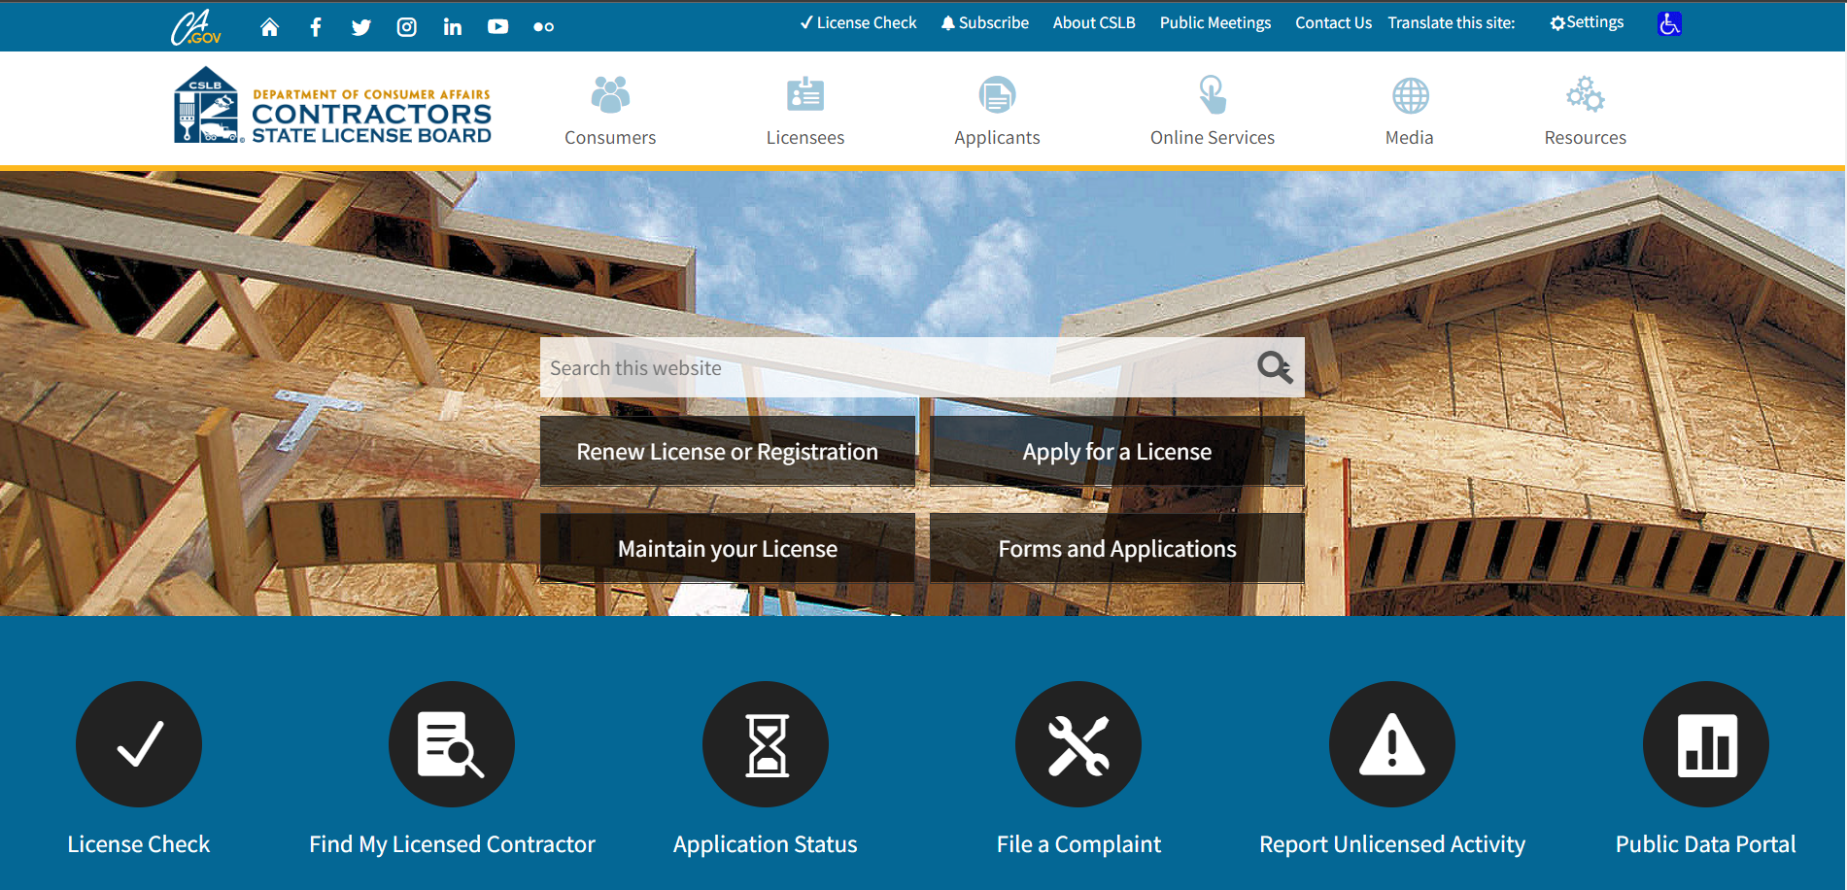
Finding a Contractor
Friends and Family

Slide 14
Finding a Contractor
Friends and Family
Check the License on cslb.ca.gov

Slide 15
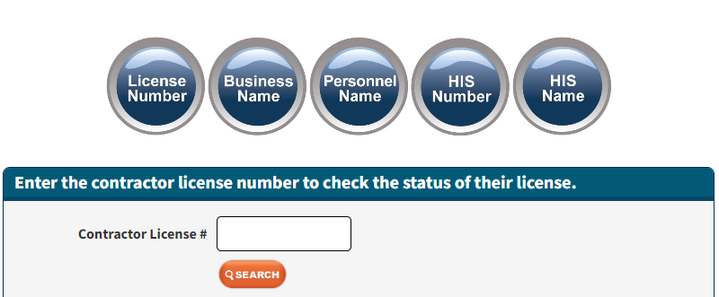
Finding a Contractor
Friends and Family
Check the License on cslb.ca.gov

Slide 16
Finding a Contractor
Check the License on cslb.ca.gov
Business Information – license expiration date
License Status – disclosed complaints
Classifications
Bonding Information
Workers’Compensation

Slide 17
Finding a Contractor
Find My Licensed Contractor tool

Slide 18
Finding a Contractor
Find My Licensed Contractor tool

Slide 19
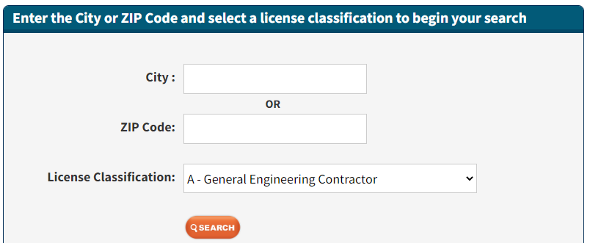
Finding a Contractor
Find My Licensed Contractor tool

Slide 20
Protect Yourself
Get at least three bids in writing.
Ask for references and check them.

Slide 21
Check the Pocket License

Slide 22
Get Three Bids
Ask about employees.
Workers’ compensation is required.
Don’t feel pressured or sign estimates

Slide 23
Written Contract
Who can negotiate the contract?
Contractor who holds the license
Home Improvement Salesperson (HIS)
Be cautious with electronic contracts
Written copy of contract required.

Slide 24
Written Contract
Progress payment schedule.
Identification of subcontractors and material suppliers so you can ensure they have been paid.
Start and completion dates.
Change orders (in writing)--both homeowner and contractor sign them.

Slide 25
Solar Projects
CSLB Solar Task Force
Solar Smart page on cslb.ca.gov

Slide 26
Is Solar Right for You?
Length of Time in Home
Roof Direction
Do the Math with Solar
Look at Monthly Statements

Slide 27
Solar Reminders
Solar is Not Free
Beware of Financing Programs: PACE, HERO, CHEEF, or REEL
High Interest Rates
Tied to Property Taxes

Slide 28
Protect Yourself
Make Sure You Have Control Over Payments
Get Everything in Writing
Financing Estimate & Disclosure Document
Read the Contract Carefully

Slide 29
Protect Yourself
Hire licensed contractors using the “Find My Licensed Contractor” tool on cslb.ca.gov.

Slide 30
Finding a Contractor
Find My Licensed Contractor tool

Slide 31
Protect Yourself
Hire licensed contractors using the “Find My Licensed Contractor” tool on cslb.ca.gov.
Check the License
Online: “Instant License Check” on cslb.ca.gov
Phone: 1-800-321-CSLB (2752)

Slide 32
Finding a Contractor
Check the License on cslb.ca.gov

Slide 33
Finding a Contractor
Check the License on cslb.ca.gov

Slide 34
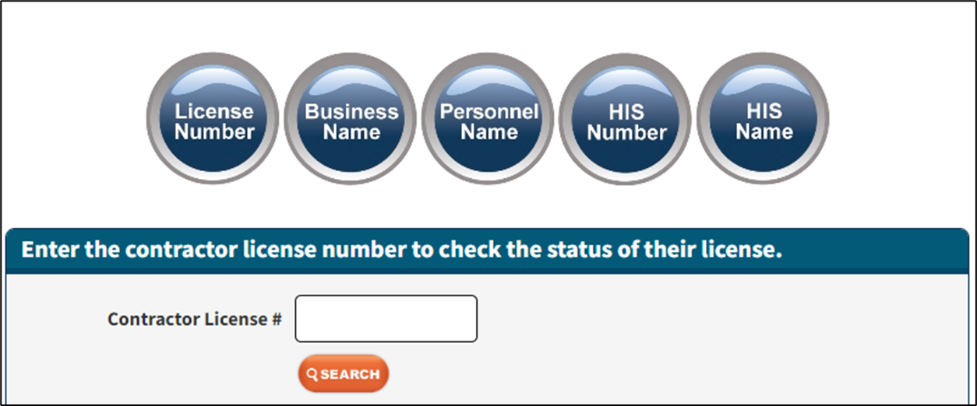
Finding a Contractor
Check the License on cslb.ca.gov

Slide 35
Remember!
Down Payment must be no more than 10 percent or $1,000 whatever is less.
Don’t let the payments get ahead of the work.

Slide 36
Contractors State License Board
Phone: 1-800-321-CSLB (2752)
Email: social@cslb.ca.gov

Slide 38
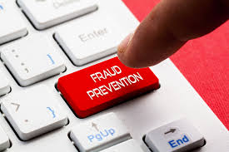
Protect Yourself from Fraud
Antonia Villaseñor
Targeted Outreach Specialist
Notes:
Who I am:
One of the Targeted Outreach Specialist with the DFPI located in the LA Office.
I have over 25 years of state service beginning 1999 in the Enforcement Division serving on the front lines of consumer services.
Since 2001, I began dedicating my work in the community presenting financial literacy topics to inform seniors on recognizing warning signs of financial and investment frauds and scams to help prevent falling prey within the LA County Region.

Slide 39
DFPI’S RESPONSIBILITIES
Licensing financial services, products and professionals
Examining licensees to ensure compliance with state laws and maintenance of accurate records
Enforcing state financial laws
Investigating consumer complaints against Department licensees and potential cases of unlicensed activity
Education & Outreach help Californians avoid financial fraud and make informed and safe financial decisions.
Notes:
The Department’s authority comes from the state legislators who pass laws regulating financial servicers and give the DFPI authority to carry out the laws.
People and companies who are providing financial services in California need to be licensed
We have teams of examiners for the different kinds of licensees
We have attorneys and investigators who work inhouse and are sometimes loaned to other law enforcement agencies to help with cases where we have shared jurisdiction

Slide 40
About the DFPI
The Department licenses and regulates a variety of financial services, products and professionals
Banks & Credit Unions
“Pay-as-you-go” financing
Money Transmitters
Deferred Deposit Transaction Originators (commonly known as payday loans)
Investment Advisers, Securities Brokers and Dealers
California Residential Mortgage Lenders
Debt Collectors
Credit repair agencies and consumer credit reporting companies

Slide 41
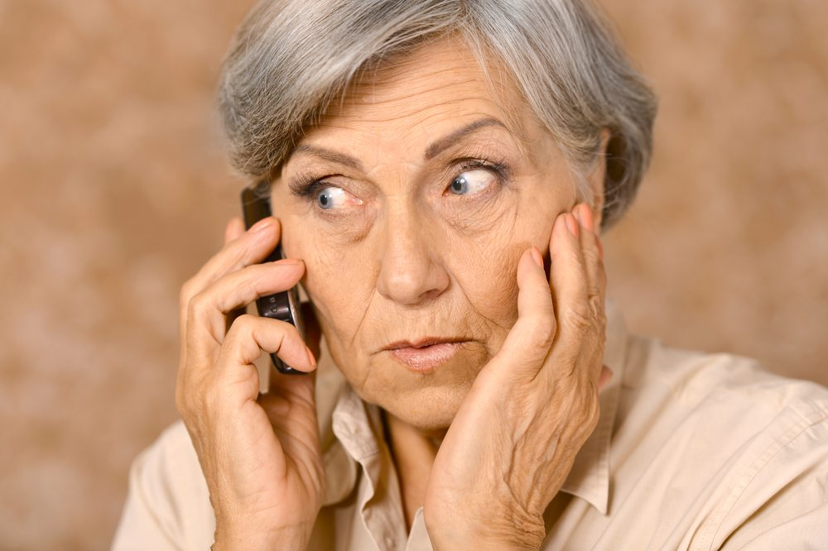
HELLO… WHO’S CALLING?
What’s Trending:
Grandparent/relative
Credit Card
Financial Relief
IT Help
Affinity Fraud
Imposters:
Government
Social Security
IRS
Financial Institutions
TIP
Gift cards are for GIFTS
NOT for emergencies or bills!

Slide 42
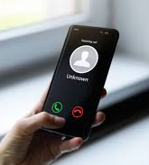
VISHING PHISHING SMISHING
Telephone
Computer/Emails
Text Messages
Click here
Callback number
Notes:
Next slides provides visual examples

Slide 43
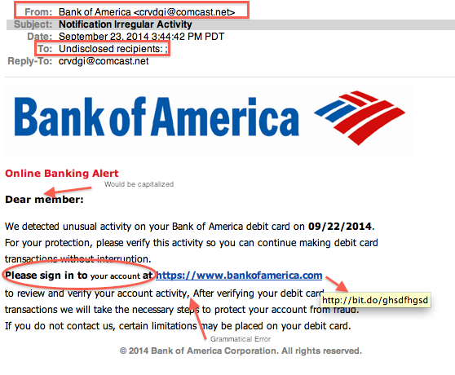
Real or Fake?

Slide 44
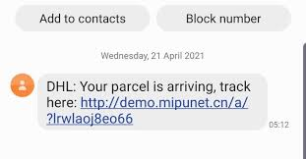
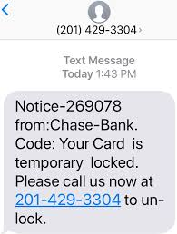
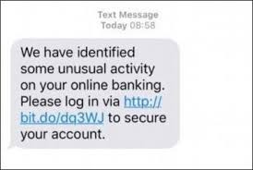
Notes:
What are some cyber safety tips!
NEXT SLIDE

Slide 45
Signs of an online dating scam
Signs of an online dating scam
Professes love quickly.
Asks for money, and lures you off the dating site.
Plans to visit, but can’t because of an emergency.
Notes:
Seniors are excited to be a part of this modern technology, are lonely, isolated and welcome the attention whether via phone call and now internet
These online interactions, which can occur on dating apps, social media, or other websites, involve scammers forming fake romantic relationships with victims in order to manipulate them and take their money,
Here are some signs:
READ LIST and then add…
A recent report from the FBI Internet Crime Complaint Center reports more than 3,000 Californians fell victim to online romance scams last year, losing a total of nearly $184 million and its climbing! Don’t have pay to find love this way, you might find yourself in financial shambles!
Lets Review:
NEXT SLIDE

Slide 46
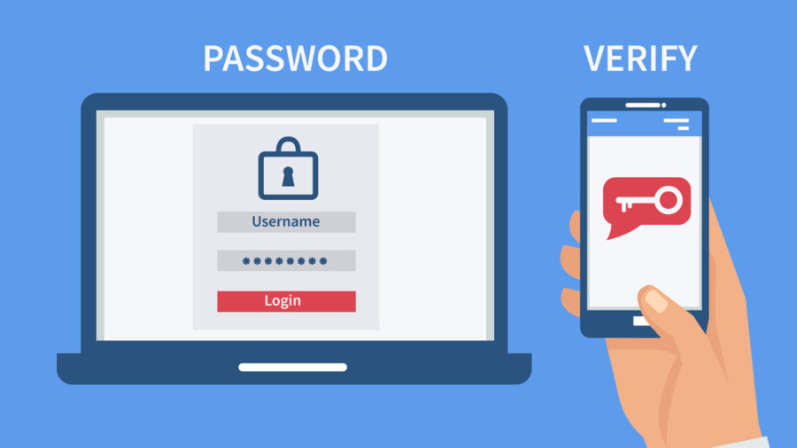
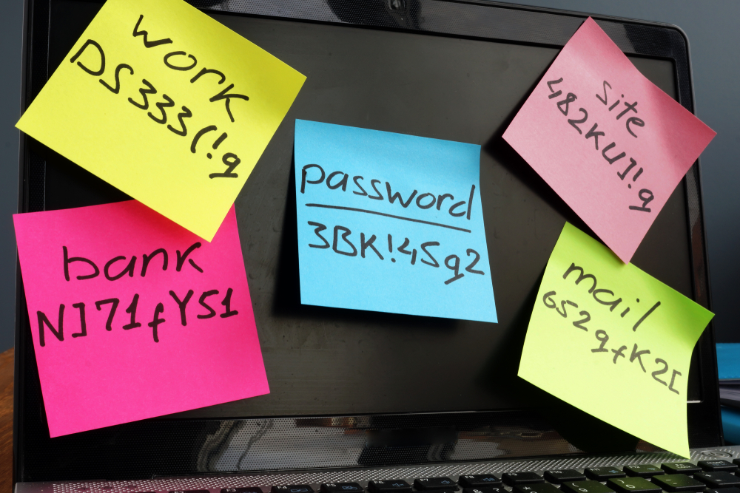
Limit Personal Information
CYBER SAFETY
Secure Network
2-Step Verification
Cell Phone, Pin Number
Passwords

Slide 47
Safeguarding Your Personal
and Financial Information
What Can I do?
Don’t answer the phone/Hang up!
Verify that there is an issue
Never give personal information
Be cautious of links sent via text.
Anti-Fraud Pen for Check Writers
Monitoring & Freezing Your Credit
www.annualcreditreport.com
Experian, Equifax, Transunion
If you are a victim of identity theft:
file a complaint with the Federal Trade Commission (FTC) at: reportfraud.ftc.gov

Slide 48
How can the DFPI help you?
Learn about us: https://dfpi.ca.gov
Contact DFPI: 866-275-2677
Have a question? Email us: ask.dfpi@dfpi.ca.gov
Interested in a publication or presentation? Email us at: outreach@dfpi.ca.gov
Stay in Touch With Us!
Subscribe to our Communications: www.dfpi.ca.gov/subscribe
Follow us on Social Media: www.dfpi.ca.gov/#social

Slide 49
THANK
YOU

Slide 51
California Department of Insurance
Armine Sargsyan
Outreach Analyst
Community Relations & Outreach

Slide 52
California Department of Insurance (CDI)
State Agency
Regulate all lines of insurance
Regulate Insurance Companies, Agents, & Brokers
Protect consumers from fraud and abuse
California is the largest insurance market in the U.S.
$340 billion collected annually in premiums

Slide 53
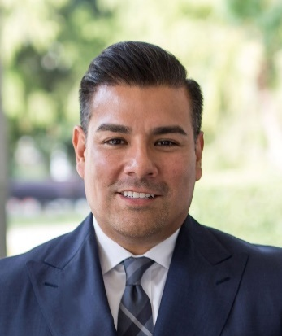
Actions Taken by Commissioner Lara
Reached over 40,000 consumers in 2021 through 275 Virtual Town Halls, briefings and events to assist during the pandemic.
Financial relief – $3 Billion in premium refunds for motorists, largest in the country.
More than $134 million recovered for Californians in 2021 through investigation of 40,000 consumer complaints into insurance company practices.

Slide 54
What Seniors Need to Know
Seniors are the largest population targeted for scams
Why are seniors big targets?

Slide 55
Most Common Insurance Fraud
ANNUITIES
What is it?
Is it RIGHT for you?
Pros
Cons

Slide 56
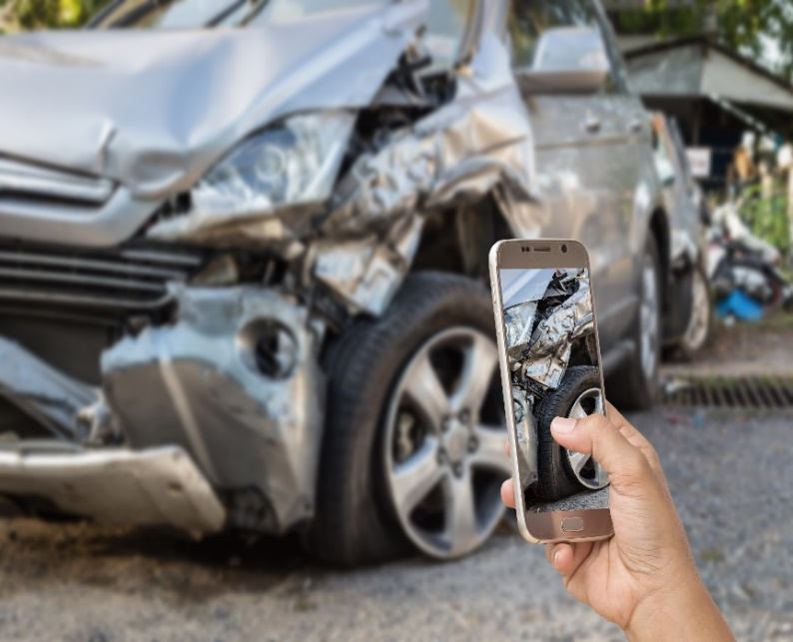
Common Insurance Scams
Premium Theft
Staged auto accidents
COVID 19 Insurance Fraud

Slide 57
COVID-19 Scam
Scammers are selling fake and unauthorized at-home COVID-19 test kits in exchange for your personal or medical information.
They can fraudulently bill federal health care programs
or commit medical identity theft.
Report COVID-19 fraud to OIG.HHA.gov
or call 800-447-8477.

Slide 58
Insurance Scam Warning Signs
The agent
offers “free” seminars
offers “free” meals
offers to create or update a living trust
gives you wrong information about your current investments
Senior Insurance Bill of Rights (SIBOR)

Slide 59
Avoid Becoming a Victim
Check the status of insurance agent/insurance company
Answer all questions thoroughly and truthfully
Get everything in writing
and compare policies
ASK QUESTIONS
Never feel pressured or intimidated
Don’t sign anything you
do not understand

Slide 60
Insurance Fraud Resources
& Contacts
Department of Insurance
800-927-4357 www.insurance.ca.gov
Senior Medicare Patrol
855-613-7080
AARP Fraud Watch Network Hotline
877-908-3360
Coalition Against Insurance Fraud
www.InsuranceFraud.org

Slide 61
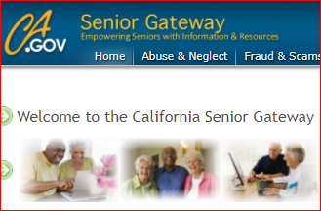
Senior Resources from CDI
Senior Gateway – www.seniors.insurance.ca.gov
One-Stop Website – hosted by CDI
Senior Information Guides

Slide 62
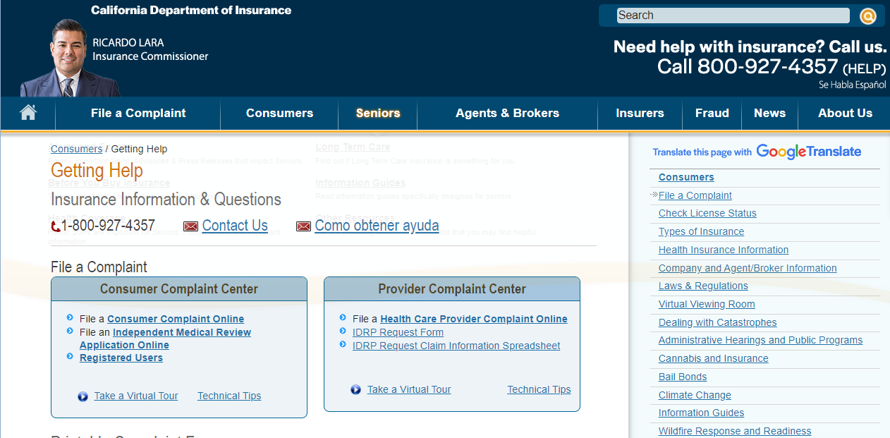
Contact Info for Consumers
Department of Insurance
Consumer Hotline 800-927-4357
Website: www.insurance.ca.gov

